Slide 1
WorkshopPLUS - Windows PowerShell: Foundation Skills
Notes:
Version: 02/08/2019 13:40:01

Slide 2
Disclaimer

Slide 3
Operators and Pipelining

Slide 4
Learnings Units covered in this Module
Introduction to Operators
Understanding the Windows PowerShell Pipeline
Working with Pipelining
Different types of Operators

Slide 5
Introduction to Operators

Slide 6
After completing Introduction to Operators, you will be able to:
Use operators to make code decisions

Slide 7
Comparison Operators

Slide 8
Comparison Operators
Compare values
Useful when testing conditions (If, Switch, Where-Object, etc.)
Do not use = , > , < , ==, etc. to compare values
Object type on left governs comparison
Notes:
Always returns Boolean if scalar input, matches if collection input

Slide 9
Comparison Operators - Basic
No Wildcards
Case-Insensitive Version
-eq | Equals | -ceq | -ieq
-ne | Not Equals | -cne | -ine
-gt | Greater Than | -cgt | -igt
-ge | Greater Than or Equal To | -cge | -ige
-lt | Less Than | -clt | -ilt
-le | Less Than or Equal To | -cle | -ile
Case-Sensitive Version

Slide 10
Basic Operators
PS C:\> 1 -eq 1
True
PS C:\> 1 -eq 2
False
PS C:\> 10 -gt 20
False
PS C:\> 10 -gt 5
True

Slide 11
Basic Operators
PS C:\> $true -eq ‘$false’
True
PS C:\> 'PowerShell' -gt 'CMDPrompt'
True
PS C:\> 'a' –lt 'aa' True
PS C:\> $service = Get-Service bits
PS C:\> $service.Status -eq 'Running'
True

Slide 12

Demonstration
Operators

Slide 13
Comparison Operators - Wildcards
Case-Insensitive Version
-like | Equals with wildcards | -clike | -ilike
-notlike | Not Equals with wildcards | -cnotlike | -inotlike
Case-Sensitive Version
Allowed Wildcards
* | Zero or any number of any chars
? | Exactly one of any char
[1az9] | Exactly one of given char(s)
[a-l] | Exactly one of range of given char(s)

Slide 14
-Like
PS C:\> 'Pear' -eq 'p*'
False
PS C:\> 'Pear' -like 'p*'
True
PS C:\> $Process = Get-Process -Name Sys*
PS C:\> $Process
Handles NPM(K) PM(K) WS(K) VM(M) CPU(s) Id ProcessName
------- ------ ----- ----- ----- ------ -- -----------
724 0 8972 628 13 51.33 4 System
PS C:\> $Process.Name -like '???????*'
False
Must be 7 chars followed by zero or more

Slide 15
Comparison Operators – Regular Expressions
See Get-Help about_Regular_Expressions
-match | Regular Expression comparison | -cmatch | -imatch
-notmatch | Regular Expression NOT comparison | -cnotmatch | -inotmatch
Case-Sensitive Version

Slide 16
-Match
PS C:\> 'Digit 5 in this string' -match '\d'
True
PS C:\> 'hello there' -match '^there'
False
PS C:\> ‘Program Files' -match ‘files$’
True
\d - Digit
^ - Start of Text
$ - End of Text
See Get-Help about_Regular_Expressions for syntax

Slide 17
Comparison Operators – Array/Collection Containment
Always results in Boolean (True/False)
Case-Sensitive Version
Array on left, Singleton on Right
-contains | Array Contains single | -ccontains | -icontains
-notcontains | Array not Contains single | -cnotcontains | -inotcontains
Case-insensitive Version
Singleton on left, Array on Right
-in | Single in Array | -cin | -iin
-notin | Single not in Array | -cnotin | -inotin
-in, -notin, inotin introduced by PowerShell v3.0

Slide 18
Array Containment
PS C:\> 1,2,3 -contains 2
True
PS C:\> "a","b","c" -notcontains “a"
False
PS C:\> 2 -in 1,2,3
True
PS C:\> "a" -notin "a","b","c"
False

Slide 19
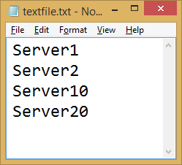
Array Containment
PS C:\> (Get-Process).Name -contains 'Notepad'
True
PS C:\> $ServerList = Get-Content .\textfile.txt
PS C:\> $ServerList -contains 'Server10'
True
PS C:\> 'Server20' -in $ServerList
True

Slide 20
Operator Case Sensitivity
PS C:\> "abcd" -eq "ABCD"
True
PS C:\> "abcd" -like "ABC*"
True
PS C:\> "abcd" -match “ABCD$"
True
PS C:\> "abcd" -ceq "ABCD"
False
PS C:\> "abcd" -clike "ABC*"
False
PS C:\> "abcd" -cmatch “ABCD$"
False

Slide 21
Demonstration
Advanced Operators

Slide 23
Logical Operators

Slide 24
Logical Operators
Connect statements
Compound conditions
Operator | Description
-and | TRUE only when both statements are TRUE.
-or | TRUE when either or both statements are TRUE.
-xor | TRUE only when one of the statements is TRUE and the other is FALSE.
-not or ! | Negates the statement that follows it.

Slide 25
-and, –or, –xor, -not, !
PS C:\> (4 –lt 8) –and (5 –lt 10)
True
PS C:\> (4 –lt 8) –or (5 –lt 4)
True
PS C:\> (4 –lt 8) –xor (5 –lt 10)
False
PS C:\> -not (4 –lt 8)
False
PS C:\> !(Test-Path C:\Windows)
False
PS C:\> (5 –lt 3 –or 4 –lt 8) –and (5 –lt 10 –and 20 –gt 10)
True
Notes:
You can also combine statements using parentheses.
The following example will still be True as 1 of the first statement blocks is true and both second statement blocks are true:
(5 –lt 3 –or 4 –lt 8) –and (5 –lt 10 –and 20 –gt 10)

Slide 26
Demonstration
Logical operators

Slide 27
Range Operators

Slide 28
Range Operator
Numerical
PS C:\> 1..10
1
2
3
4
5
6
7
8
9
10
PS C:\> 11..20
11
12
13
14
15
16
17
18
19
20
PS C:\> 5..-4
5
4
3
2
1
0
-1
-2
-3
-4
PS C:\> -1..-9
-1
-2
-3
-4
-5
-6
-7
-8
-9

Slide 29
Range of Characters Operator
Alphabetical [<letter>-<letter>]
Used with –Like,-NotLike and Parameters that accept wildcards
PS C:\> Get-ChildItem C:\windows\System32\[a-d]*
Directory: C:\windows\System32
Mode LastWriteTime Length Name
---- ------------- ------ ----
d---- 22/08/2013 11:36 AM AdvancedInstallers
d---- 20/05/2014 8:22 AM AppLocker
d---- 19/10/2013 8:19 AM Appmgmt
d---- 8/04/2014 7:38 PM Ar-SA
d---- 19/10/2013 12:05 PM BestPractices
...

Slide 30
Specified Characters Operator
Alphabetical [<letter><letter>]
Used with –Like,-NotLike and Parameters that accept wildcards
PS C:\> Get-ChildItem C:\windows\System32\[jz]*
Directory: C:\windows\System32
Mode LastWriteTime Length Name
---- ------------- ------ ----
d---- 23/08/2013 1:36 AM ja-JP
d---- 23/08/2013 1:36 AM zh-CN
-a--- 23/08/2013 5:12 AM 25600 jnwmon.dll
-a--- 22/08/2013 9:03 PM 142848 joy.cpl
-a--- 22/08/2013 9:01 PM 429568 zipfldr.dll
...

Slide 32
Numeric Multipliers

Slide 33
Numeric Byte Multipliers
Convenient byte multiples
Commonly-used powers of 2
Case-insensitive
Multiplier | Meaning | Example
kb | kilobyte (n * 1024) | PS C:\> 2kb 2048
mb | megabyte (n * 1024 x 1024) | PS C:\> 100mb 104857600
gb | gigabyte (n * 1024 x 1024 x 1024) | PS C:\> 1.5gb 1610612736
tb | terabyte (n * 1024 x 1024 x 1024 x 1024) | PS C:\> 1tb 1099511627776
pb | petabyte (n * 1024 x 1024 x 1024 x 1024 x 1024) | PS C:\> 1pb 1125899906842624

Slide 34
Demonstration
Numeric Byte Multipliers

Slide 35
Introduction to Operators
Notes:
Link to lab:

Slide 36
Understanding the Windows PowerShell Pipeline

Slide 37
After completing Understanding the Windows PowerShell Pipeline, you will be able to:
Work with the powershell Pipeline
Understand how the basic commands interact with the Pipeline

Slide 38
What is a pipeline?

Slide 39
What is a Pipeline?
Series of commands connected by the pipeline character.
Broken vertical bar
Passes OBJECT, not text, Left to Right starting with first command.
Each subsequent command takes its Input from the previous command’s Output
Allows Filtering, Formatting and Outputting
Cmdlets are designed to be in a pipeline
Pipeline statements typically start with a “Get” command which introduces the objects to be used throughout the statement.
Increases performance of operations by allowing simultaneous execution
|

Slide 40
Using the Pipeline
Sends output from one command as input to another command
Pipeline statements typically start with a “Get” command which introduces the objects to be used throughout the statement.
Increases performance of operations by allowing simultaneous execution of each portion of pipeline statement.
PS C:\> Get-Service -Name Schedule , BITS | Start-Service
1
2
Get-Service -Name Schedule
Start-Service -Name Schedule
2
Get-Service -Name BITS
3
Start-Service -Name BITS
Order of Operations
1. Get-Service –Name Schedule
2. Start-Service –Name Schedule | 2. Get-Service –Name Bits
3. Start-Service –Name Bits
(Happens Simultaneously)
Notes:
Commands in the pipe can be executed simultaneous decreasing runtime.

Slide 41
The “Get” Cmdlets
Typically placed first in the pipeline
Provides the input to be processed
Returns schedule and bits services
PS C:\> Get-Service -Name Schedule , BITS | Start-Service
Takes an action on the services

Slide 42
External Commands
Can be used as input to the pipeline
External command
PS C:\> whoami.exe
Contoso\power
PS C:\> whoami.exe | Split-Path -Parent
contoso
PS C:\> whoami.exe | Split-Path -Leaf
power

Slide 43
Text File Input
Text files provide input to be processed by the pipeline
Reads a text file
PS C:\> Get-Content .\services.txt | Get-Service
Takes an action on each line in the file

Slide 44
Pipeline Input
Commands that get information are very suitable for use in the pipeline like the “Get-” commands
Pipeline input can be any object
PowerShell will bind properties from the input object on the left to the new command on the right

Slide 45
The “Get” Cmdlets
Typically placed first in the pipeline
Provides the input to be processed
Returns schedule and bits services
PS C:\> Get-Service -Name Schedule , BITS | Start-Service
Takes an action on the services

Slide 46
Demonstration
Pipeline Basics and Optimization

Slide 48
Object Cmdlets

Slide 49
Object Cmdlets
Name | Description
Sort-Object | Sorts objects by property values
Select-Object | Selects object properties
Group-Object | Groups objects that contain the same value for specified properties
Measure-Object | Calculates numeric properties of objects, and the characters, words, and lines in string objects, such as text files
Compare-Object | Compares two sets of objects

Slide 50
Sort-Object and Select-Object
Get all processes, Sort by virtual memory then Select top 2
PS C:\> Get-Process | Sort-Object VM -Descending | Select-Object -First 2 Handles NPM(K) PM(K) WS(K) VM(M) CPU(s) Id ProcessName ------- ------ ----- ----- ----- ------ -- ----------- 1283 55 21020 30340 1237 477.78 304 svchost 1926 44 285244 230112 1165 716.45 4124 livecomm

Slide 51
Group-Object
Get security event log then Group by entry type
PS C:\> Get-EventLog -LogName Security | Group-Object EntryType Count Name Group ----- ---- ----- 18105 SuccessAudit {System.Diagnostics.EventLogEntry,Sys... 25 FailureAudit {System.Diagnostics.EventLogEntry,Sys...

Slide 52
Measure-Object
Get files in c:\scripts then Measure their number (count) and total size (length) in bytes
PS C:\> Get-ChildItem C:\Scripts | Measure-Object -Property Length -Sum Count : 2 Average : Sum : 217837 Maximum : Minimum : Property : Length

Slide 53
Compare-Object
Comparing text files
PS C:\> $ref = Get-Content -Path .\servers1.txt PS C:\> Get-Content -Path .\servers2.txt | Compare-Object -ReferenceObject $ref InputObject SideIndicator ----------- ------------- Server3 =>
“Server3” is only in the difference variable (servers2.txt)
Notes:
Compare object compares a single property, it can not be used to compare arrays, hash tables, pscustom objects or multi-dimentional array`s

Slide 54
Demonstration
Object Cmdlets in the Pipeline

Slide 56
Format Cmdlets

Slide 57
Format Cmdlets
Convert pipeline objects into formatted output, typically for human consumption
Should be last Cmdlet on the pipeline (only followed by Out-* Cmdlets)
Format-List
-Property * lists all properties
-Autosize
Format-Wide
-Wrap
-Autosize
-Column
Key Parameters:
Key Parameters:
Key Parameters:
Format-Table

Slide 58
Format-List With Default Properties
PS C:\> Get-Process -Name powershell | Format-List Id : 6400 Handles : 472 CPU : 0.78125 Name : powershell
Output is in list format
Properties chosen are based on default formatting in PowerShell by object type

Slide 59
Format-List With Apecific Properties
PS C:\> Get-Process -Name powershell | Format-List -Property Name, BasePriority, PriorityClass Name : powershell BasePriority : 8 PriorityClass : Normal
Output in list format
Consists of specified properties
Notes:
4

Slide 60
Format-Table With Default Properties
PS C:\> Get-Process | Format-Table Handles NPM(K) PM(K) WS(K) VM(M) CPU(s) Id ProcessName ------- ------ ----- ----- ----- ------ -- ----------- 82 7 1308 1420 45 0.14 2308 armsvc 195 13 2568 3440 94 3.78 1192 atieclxx 110 6 852 1172 23 0.09 868 atiesrxx 565 20 6384 7092 113 42.14 4308 BasisSync 180 12 2276 2660 89 0.41 7744 BDAppHost 142 11 1860 1768 76 0.14 7712 BDExtHost 335 24 12120 14988 126 1.31 7772 BDRuntimeHost 413 31 8128 10668 209 1.39 6636 BingDesktop . . .

Slide 61
Format-Table With Specific Properties
PS C:\> Get-Process | Format-Table –Property name,workingset,handles Name WorkingSet Handles ---- ---------- ------- csrss 847872 216 csrss 356352 91 csrss 15646720 183 dwm 7045120 176 dwm 30498816 201 explorer 37539840 1427 Idle 4096 0 LogonUI 6897664 367 lsass 7622656 1050 MsMpEng 24444928 528 powershell_ise 144850944 515 ...

Slide 62
Format-Table With Specific Properties and -AutoSize
PS C:\> Get-Process | Format-Table -Property name,workingset,handles -AutoSize Name WorkingSet Handles ---- ---------- ------- csrss 843776 216 csrss 356352 91 csrss 15523840 183 dwm 7045120 176 dwm 30691328 201 explorer 37486592 1421 Idle 4096 0 LogonUI 6897664 367 lsass 7454720 1055 MsMpEng 22908928 527 powershell_ise 147017728 565 ...

Slide 63
Format-Table With Specific Properties
PS C:\> Get-Process | Format-Table -Property Name,Path,WorkingSet Name Path WorkingSet ---- ---- ---------- armsvc 1454080 atieclxx 3760128 atiesrxx 1200128 audiodg 11911168 BDAppHost C:\Program Fil... 2736128 BDExtHost C:\Program Fil... 1826816 BDRuntimeHost C:\Program Fil... 15331328 BingDesktop C:\Program Fil... 10981376 CCC C:\Program Fil... 5857280 . . .
Path truncated due to wide values

Slide 64
Format-Table With Auto Sized Columns
PS C:\> Get-Process | Format-Table -Property Name,Path,WorkingSet -AutoSize Name Path ---- ---- armsvc atieclxx atiesrxx BDAppHost C:\Program Files (x86)\Microsoft\BingDesktop\BDAppHost.exe BDExtHost C:\Program Files (x86)\Microsoft\BingDesktop\BDExtHost.exe BDRuntimeHost C:\Program Files (x86)\Microsoft\BingDesktop\BDRuntimeHost... BingDesktop C:\Program Files (x86)\Microsoft\BingDesktop\BingDesktop.exe CCC C:\Program Files (x86)\ATI Technologies\ATI.ACE\Core-Stati... ...
Path property truncation is minimized with –Autosize, but workingset column lost

Slide 65
Format-Table With Wrap
PS C:\> Get-Process | Format-Table -Property Name,Path,WorkingSet -AutoSize –Wrap Name Path ---- ---- armsvc atieclxx atiesrxx BDAppHost C:\Program Files (x86)\Microsoft\BingDes ktop\BDAppHost.exe BDExtHost C:\Program Files (x86)\Microsoft\BingDes ktop\BDExtHost.exe BDRuntimeHost C:\Program Files (x86)\Microsoft\BingDes ktop\BDRuntimeHost.exe BingDesktop C:\Program Files (x86)\Microsoft\BingDes ktop\BingDesktop.exe
Path property is line wrapped, workingset still lost in this case

Slide 66
Format-Table With Grouping
Processes are grouped by BasePriority (need to sort by groupby prop first)
PS C:\> Get-Process | Sort-Object -Property BasePriority | Format-Table -GroupBy BasePriority -Wrap -AutoSize BasePriority: 0 Handles NPM(K) PM(K) WS(K) VM(M) CPU(s) Id ProcessName ------- ------ ----- ----- ----- ------ -- ----------- 0 0 0 24 0 0 Idle ... PS C:\> Get-EventLog -LogName Security | Group-Object EntryType | Format-Table -AutoSize -Wrap Count Name Group ----- ---- ----- 181027 SuccessAudit {System.Diagnostics.EventLogEntry} 25 FailureAudit {System.Diagnostics.EventLogEntry}
Autosize minimizes data truncation, wrap eliminates it

Slide 67
Format-Wide – Default 2 Columns
PS C:\> Get-ChildItem | Format-Wide Directory: C:\ [PerfLogs] [Program Files] [Program Files (x86)] [PShell] [Users] [Windows]
Output displayed in 2 columns by default

Slide 68
Format-Wide – Explicit Number of Columns
PS C:\> Get-ChildItem | Format-Wide -Column 3 Directory: C:\ [PerfLogs] [Program Files] [Program Files (x86)] [PShell] [Users] [Windows]
Output displayed in 3 columns

Slide 69
Demonstration
Format Cmdlets

Slide 71
Export and Import Cmdlets

Slide 72
Export Cmdlets
Export objects to text file
Provides structured information which can be imported
Should be last cmdlet on the pipeline
Export-Csv
-Path
Export-CliXml
Key Properties
-Delimiter
-Depth
Key Properties:
-Path
-UseCulture
Notes:
Always validate that the delimiter is in the correct format for csv files. This can be forced using the –delimiter parameter or –UseCulture parameter.

Slide 73
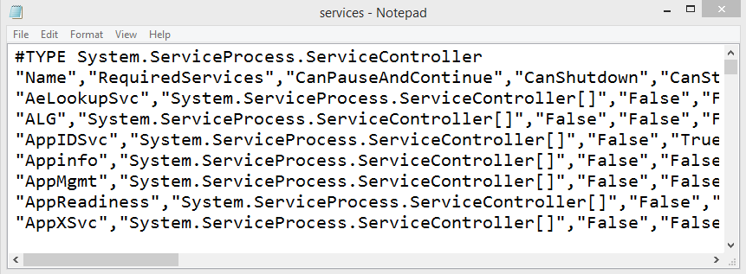
Export-CSV
 | PS C:\> Get-Service | Export-Csv c:\services.csv PS C:\> notepad.exe C:\services.csv
-NoTypeInformation parameter avoids this as 1st line

Slide 74
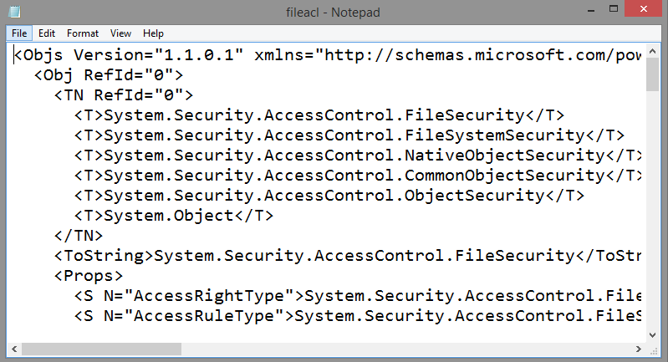
Export-Clixml
 | PS C:\> get-acl C:\Process.txt -Audit | Export-Clixml -Path fileacl.xml PS C:\> notepad .\fileacl.xml

Slide 75
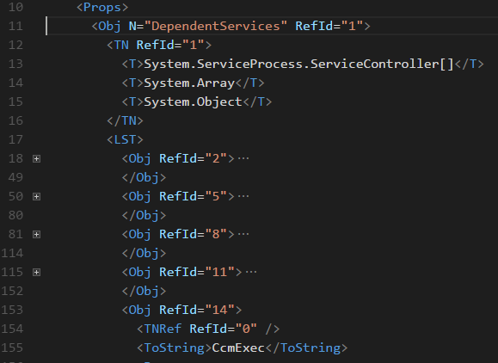
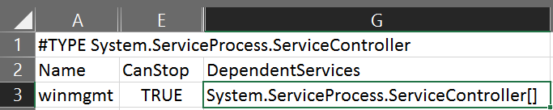
When to use CliXml?
XML is much better at representing hierarchical data by preserving the data types
Notes:
Get-service winmgmt | select dependantservices
The CSV can’t display that data
The XML can, in the <OBJ M=“DependantServices”> tag we can see a child <LST>
<LST> shows us all the dependence services as separate <OBJ> tags
The button one, RefID=“14” is expanded to show the service name “CcmExec”

Slide 76
Import Cmdlets
Imports objects from text file
Should be first cmdlet on the pipeline
Import-Csv
-Path
Import-CliXml
Key Properties
-Delimiter
Key Properties:
-Path
-UseCulture
Notes:
Always validate that the delimiter is in the correct format for csv files. This can be forced using the –delimiter parameter or –UseCulture parameter.

Slide 77
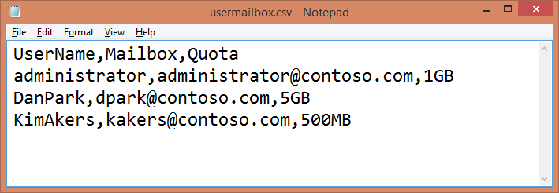
Import-Csv
PS C:\> Import-Csv C:\usermailbox.csv | Select-Object mailbox
Mailbox
-------
administrator@contoso.com
dpark@contoso.com
kakers@contoso.com

Slide 78
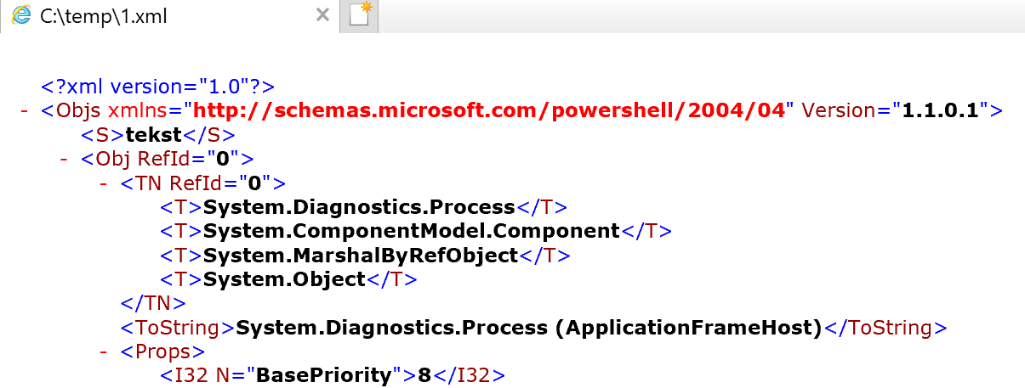
Import-CliXml
PS C:\> Import-Clixml -Path 'C:\temp\1.xml'
tekst
Handles NPM(K) PM(K) WS(K) CPU(s) Id S
I
------- ------ ----- ----- ------ -- -
811 44 31340 68712 4,53 9452 2

Slide 79
Demonstration
Import and Export cmdlets

Slide 81
Out Cmdlets

Slide 82
Out Cmdlets
Sends command output to a specified device
Name | Description
Out-Default | Sends output to default formatter and to default output cmdlet (Out-Host)
Out-File | Sends output to a file Append switch parameter Encoding parameter allows control of the character encoding
Out-GridView | Sends output to an interactive table in a separate GUI
Out-Host | Default Sends output to PowerShell host Paging switch parameter displays one page at a time
Out-Null | Deletes output instead of sending it down the pipeline
Out-Printer | Sends output to a printer
Out-String | Sends objects to the host as a series of strings

Slide 83
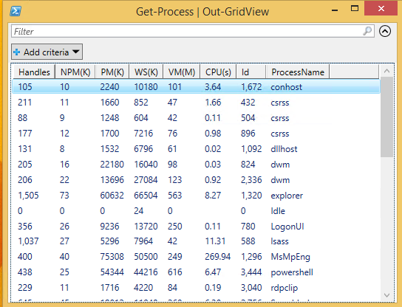
Out-Gridview
PS C:\> Get-Process | Out-GridView

Slide 84
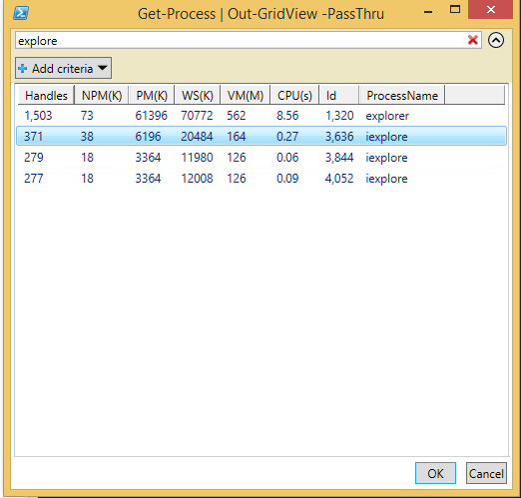
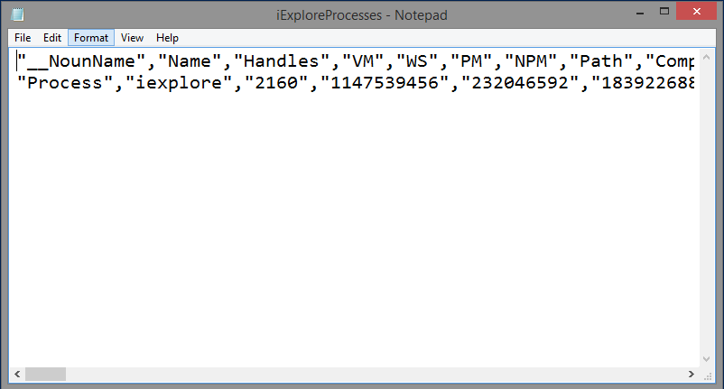
Out-Gridview with PassThru
Step 1: Send Get-Process output to Out-Gridview with PassThru switch parameter, followed by export to CSV
PS C:\> Get-Process | Out-GridView -PassThru | Export-Csv c:\scripts\iExploreProcesses.csv -NoTypeInformation
Step 3: View filtered output in CSV
Step 2: Filter using GUI. Click to select output items
Notes:
Out gridview can be used multiple times with the “Passthru” parameter to keep narrowing down your selection of random data.
Example:
Get-process | out-gridview -PassThru | sort-object -property name | out-gridview -PassThru | export-clixml -path c:\temp\output.xml

Slide 85
Demonstration
Out-* Cmdlets

Slide 87
Understanding the Windows PowerShell Pipeline
Notes:
Link to lab:

Slide 88
Working with Pipelining

Slide 89
After completing Working with Pipelining, you will be able to:
Work with advanced Pipeline objects

Slide 90
Pipeline Variable

Slide 91
Pipeline Variables
When multiple objects are piped, PowerShell sends objects one at a time
Built-in variables $_ and $PSItem represent current object on pipeline
Used to perform an action on every object
Use -PipelineVariable parameter to name your own variable on the pipeline
Scoped only to current pipeline

Slide 92
Pipeline Variables - Examples
Default Pipeline variables:
Both lines produce the same result
PS C:\> Get-Process | Where-Object {$psitem.ws -gt 100MB} PS C:\> Get-Process | Where-Object {$_.ws -gt 100MB}
User defined variables:
Storing cmdlet output in a user-defined variable
PS C:\> Get-Process -PipelineVariable CurrentProcess | Where-Object {$CurrentProcess.ws -gt 100MB}
Notes:
The PipelineVariable parameter is a new common parameter for PSv4.

Slide 93
Demonstration
Pipeline Variables

Slide 94
More Object Cmdlets

Slide 95
Other Object Cmdlets
Cmdlet | Usecase
ForEach-Object | Performs an operation against each item. Aliases: % ForEach
Where-Object | Filters objects in the pipeline Aliases: ? Where

Slide 96
ForEach-Object
Take an action on each object
PS C:\> Get-Service net* | ForEach-Object –process {"Hello " + $_.Name} Hello Netlogon Hello Netman Hello netprofm Hello NetTcpPortSharing

Slide 97
Pipeline Filtering With Where-Object
Get-ChildItem –path c:\windows –filter *.ini |`
Where-Object –filterscript {$_.length -lt 10kb} |`
Sort-Object -property Length |`
Format-Table -property name, length
(FileInfo) (*.ini)
Get-ChildItem –path c:\windows –filter *.ini
(FileInfo) (*.ini)
(Length < 10240)
Where-Object {$_.length -lt 10kb}
(FileInfo) (*.ini)
(Length < 10240)
(Sorted by length)
Sort-Object -property Length
(FileInfo) (*.ini)
(Length < 10240)
(Sorted by length)
(Formatted in table)
Format-Table -property name, length

Slide 98
Where-Object (Simple syntax)
Simplified filtering syntax
Syntax emulates natural language
PowerShell v3.0+
Note: Multiple filter conditions need full syntax
PowerShell v1.0+
PS C:\> Get-ChildItem | Where-Object { $_.Length –gt 1MB } PS C:\> Get-ChildItem | Where-Object { $_.PSIsContainer } PS C:\> Get-Service | Where-Object {$_.Status -eq "Running" –and $_.CanShutdown}
PowerShell v3.0+ (Single comparison operator only)
PS C:\> Get-ChildItem | Where-Object Length -gt 1MB PS C:\> Get-ChildItem | Where PSIsContainer PS C:\> Get-Service | Where Status -eq Running
No compound conditions with simplified syntax
Notes:
Where-Object uses a very well defined (and strict) syntax in PS 2.0. You must provide a single parameter for the condition. It must be a Scriptblock, the code included between the curly braces {}. The parameter name (-FilterScript) is optional and generally not provided.
The scriptblock is run for each object. If the condition you provided is evaluated to $True, and only in that case, the full object will survive in the pipeline. The script block can refer to the full object by using the reserved variable name $_. Of course, you can get all its properties and set complex filters based on them.
However, PS 3.0 offers new possibilities. Where-Object offers more parameters, allowing simpler operators for common filtering scenarios. This greatly simplifies the syntax, especially removing the need to use the full scriptblock, the curly braces, and even the reference to the $_ variable.
Most of the available comparison operators are now implemented as a new parameter in Where-Object. One important improvement is that the parameter name is exactly the same as the operator, as for example in –GT.
You can continue to use the PS 2.0 syntax. You still need it in several scenarios.

Slide 99
Filtering With Parameters vs. Where-Object
Filter output with Where-Object (~11 milliseconds)
PS C:\> Get-Process | Where-Object {$_.Name -match “net"}
vs.
Filter output with parameters (~4 milliseconds)
PS C:\> Get-Process -Name *net*
PS C:\> Get-ADUser –Filter * -Properties Surname | ?{$_.Surname -eq “Snover"}
Grab All Users as Objects and Perform Filtering (3.8k Users) ~2300 milliseconds
Domain Controller
3.8k Users
vs.
Filtering occurs on DC and matching objects are returned. (1 user) ~10 milliseconds
PS C:\> Get-ADUser –Filter {Surname –eq “Snover” }
PowerShell Proverb: If a Cmdlet has a –Filter there’s a reason.

Slide 100
Automatic Member Enumeration
Retrieve single property from collection without using ForEach-Object
Single level
PS C:\> (Get-Process).ID 4300 8844 8812
Doesn’t work in PowerShell v1.0 and v2.0
Multiple levels deep
PS C:\> (Get-EventLog –Log System).TimeWritten.DayOfWeek | >> Group-Object Count Name Group ----- ---- ----- 4174 Tuesday {Tuesday, Tuesday, Tuesday...} 4349 Monday {Monday, Monday, Monday...}

Slide 101
Demonstration
Foreach-Object and Where-Object

Slide 103
Begin, Process and End Blocks

Slide 104
Foreach-Object - Anatomy
Begin Block
Statements executed once, before first pipeline object
Process Block
Statements executed for each pipeline object delivered
If called outside a pipeline context, block is executed exactly once
Default if unnamed
End block
Statements executed once, after last pipeline object

Slide 105
Foreach-Object -Process Parameter
ForEach-Object often used with positional parameter in simple scenario
PS C:\> Get-EventLog -LogName Application -Newest 5 | ForEach-Object {$_.Message | Out-File -Filepath Events.txt -Append}
Position 1 is -Process Parameter
PS C:\> Get-EventLog -LogName Application -Newest 5 | ForEach-Object -Process {$_.Message | Out-File Events.txt -Append}
Parameter can be named
Notes:
These parameters of ForEach-Object have existed since at least PSv2.

Slide 106
Begin, Process and End Parameters
ForEach-Object cmdlet supports Begin, Process, and End Parameters
Begin block → run once before any items are processed
PS C:\> Get-EventLog -LogName Application -Newest 5 | ForEach-Object -Begin {Remove-Item .\Events.txt; Write-Host "Start" -ForegroundColor Red} -Process {$_.Message | Out-File -Filepath Events.txt -Append} -End {Write-Host "End" -ForegroundColor Green; notepad.exe Events.txt}
Notes:
These parameters of ForEach-Object have existed since at least PSv2.

Slide 107
Begin, Process and End Parameters
ForEach-Object cmdlet supports Begin, Process, and End Parameters
Process block → run for each object on pipeline
PS C:\> Get-EventLog -LogName Application -Newest 5 | ForEach-Object -Begin {Remove-Item .\Events.txt; Write-Host "Start" -ForegroundColor Red} -Process {$_.Message | Out-File -Filepath Events.txt -Append} -End {Write-Host "End" -ForegroundColor Green; notepad.exe Events.txt}
Notes:
These parameters of ForEach-Object have existed since at least PSv2.

Slide 108
Begin, Process and End Parameters
ForEach-Object cmdlet supports Begin, Process, and End Parameters
End block → run once after all items have been processed
PS C:\> Get-EventLog -LogName Application -Newest 5 | ForEach-Object -Begin {Remove-Item .\Events.txt; Write-Host "Start" -ForegroundColor Red} -Process {$_.Message | Out-File -Filepath Events.txt -Append} -End {Write-Host "End" -ForegroundColor Green; notepad.exe Events.txt}
Notes:
These parameters of ForEach-Object have existed since at least PSv2.

Slide 109
Named Blocks in Functions/ScriptBlocks
Statements can be in an unnamed block or in one or more named blocks
Allows custom processing of collections coming from pipelines
Can be defined in any order
Use the Begin / Process / End blocks

Slide 110
Named Blocks
function My-Function
{
Begin
{
Remove-Item .\Events.txt
Write-Host "Start" -ForegroundColor Red
}
Process
{
$_.Message | Out-File -Filepath Events.txt -Append
}
End
{
Write-Host "End" -ForegroundColor Green
notepad.exe Events.txt
}
}
PS C:\> Get-EventLog -LogName Application -Newest 5 | My-Function

Slide 111
Demonstration
Begin Process End

Slide 113
Two ways to accept pipeline input

Slide 114
Methods Of Accepting Parameter Pipeline Input
Cmdlet parameters can accept pipeline input in one of two ways:
ByValue (Object Data Type)
ByPropertyName (Object Property Name)
Cmdlet parameters may accept pipelined objects by value, by property name or both.

Slide 115
Does a Parameter Accept Pipeline Input?
PS C:\> Get-Help Restart-Computer -Parameter ComputerName -ComputerName <String[]> Specifies one or more remote computers. The ... Required? false Position? 1 Default value Local computer Accept pipeline input? True (ByValue, ByPropertyName) Accept wildcard characters? false

Slide 116
Pipeline Input ByValue
For parameters that accept pipeline input ByValue, piped objects will bind:
To a parameter of the same TYPE
To a parameter that can be converted to the same TYPE

Slide 117
Pipeline Input ByValue
Restart-Computer ComputerName Parameter
PS C:\> Get-Help Restart-Computer -Parameter ComputerName -ComputerName <String[]> Specifies one or more remote computers. The default is ... Required? false Position? 1 Default value Local computer Accept pipeline input? True (ByValue, ByPropertyName) Accept wildcard characters? false
Pipe Computer names (strings) to Restart-Computer
PS C:\> 'MS','DC' | Restart-Computer –WhatIf What if: Performing the operation "Restart the computer." on target "MS". What if: Performing the operation "Restart the computer." on target “DC".

Slide 118
Pipeline Input ByPropertyName
For parameters that accept pipeline input ByPropertyName, piped objects properties will bind:
To parameter(s) of the same name

Slide 119
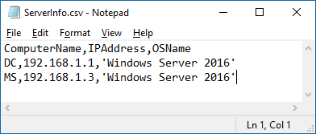
Pipeline Input ByProperty
Restart-Computer ComputerName Parameter
PS C:\> Get-Help Restart-Computer -Parameter ComputerName -ComputerName <String[]> Specifies one or more remote computers. The default is ... Required? false Position? 1 Default value Local computer Accept pipeline input? True (ByValue, ByPropertyName) Accept wildcard characters? false
Pipe Computer names (column in CSV) to Restart-Computer
PS C:\> Import-Csv .\ServerInfo.csv | Restart-Computer –WhatIf What if: Performing the operation "Restart the computer." on target "DC". What if: Performing the operation "Restart the computer." on target "MS".

Slide 120
The Parameter Binding Steps
Bind all named parameters
Bind all positional parameters
Bind from the pipeline by value with exact match
Bind from the pipeline by value with conversion
Bind from the pipeline by name with exact type match
Bind from the pipeline by name with type conversion

Slide 122
Working With Pipelining
Notes:
Link to lab:

Slide 123
Different types of Operators

Slide 124
After completing Different types of Operators, you will be able to:
Work with advanced operators
Work with text objects and manipulate them

Slide 125
Arithmetic Operators

Slide 126
Arithmetic Operators
Arithmetic operators are mathematical functions that takes two operands and performs a calculation on them
Arithmetic Operators work with more than only integer types

Slide 127
Arithmetic Operators
Operator | Description | Example(s) | Result(s)
+ | Adds integers; concatenates strings, arrays, and hash tables | 6 + 2 "file" + "name" | 8 filename
- | Subtracts values | 6 - 2 | 4
- | Indicates negative value | -6 + 2 | -4
* | Multiplies integers; copies strings and arrays | 6 * 2 "ABC" * 3 | 12 ABCABCABC
/ | Divides values | 6/2 | 3
% | Returns remainder of division (modulus) | 7%2 | 1
-shl | Shift-left bitwise | 100 -shl 2 | 400
-shr | Shift-right bitwise | 100 -shr 1 | 50
100 in binary is 1100100
-shl shifts digits n chars left
400 in binary is 110010000
100 in binary is 1100100
-shr shifts digits n chars right
50 in binary is 110010

Slide 128
Rounding Integers
Integers get rounded to the closest whole number
If the value starts with 0.5 rounding happens to the nearest even number by default
Additional rounding options available if needed
PS C:\>[int](5/2)
2
PS C:\>[int](7/2)
4
PS C:\>[int](12.5)
12
PS C:\>[int](13.5)
14

Slide 129
Demonstration
Arithmetic Operators

Slide 131
Assignment Operators

Slide 132
Assignment Operators
An assignment operator assigns a value to its left operand based on the value of its right operand.

Slide 133
Assignment Operators
Operator | Description | Example(s)
= | Sets variable | $integer = 100
+= | Increases variable | $integer += 1
-= | Decreases variable | $integer -= 1
*= | Multiplies variable | $integer *= 2
/= | Divides variable | $integer /= 2
%= | Divides variable and assigns remainder to variable | $integer %= 3
++ | Unary Operator. Increases variable by 1 | $integer++
-- | Unary Operator. Decreases variable by 1 | $integer--
$integer = $integer + 1
$integer += 1
$integer++
All produce same result

Slide 134
Unary Operators Pre And Post Processing
Pre processing will increment the value before being used
Post processing will only increment the value after being used
PS C:\> $1 = 5
PS C:\> $1
5
PS C:\> write-output -InputObject (++$1)
6
PS C:\> write-output -InputObject ($1++)
6
PS C:\> $1
7

Slide 135
Demonstration
Assignment Operators

Slide 137
Binary Operators

Slide 138
Bitwise Operators
Bitwise operators act on the binary format of a value at the level of their individual bits.
Can be used to calculate if a bit is set. ( Example User-account-control in AD )
Notes:
Binary Operators act on the binary format of a number

Slide 139
Bitwise Operators
Operator | Description | Example(s) | Binary Format
-bAnd | Bitwise AND | 10 -band 3 | 1010 (10) 0011 (3) -------- bAND 0010 (2)
-bOr | Bitwise OR (inclusive) | 10 -bor 3 | 1010 (10) 0011 (3) --------- bOR 1011 (11)
-bXor | Bitwise OR (exclusive) | 10 -bxor 3 | 1010 (10) 0011 (3) ------- bXOR 1001 (9)
-bNot | Bitwise NOT | -bnot 10 | 0000 1010 (10) ---------------- bNOT 1111 0101 (-11)
Notes:
bAND - In a bitwise AND operation, the resulting bit is set to 1 only when both input bits are 1.
bOR - In a bitwise OR (inclusive) operation, the resulting bit is set to 1 when either or both input bits are 1. The resulting bit is set to 0 only when both input bits are set to 0.
bXOR - In a bitwise OR (exclusive) operation, the resulting bit is set to 1 only when one input bit is 1.
bNOT - The bitwise NOT operator is a unary operator that produces the binary complement of the value. A bit of 1 is set to 0 and a bit of 0 is set to 1.

Slide 140
Split, Join and replace Operators

Slide 141
Split, Join, and Replace Operators
The Split, Join, and Replace operators are used to manipulate text strings
Notes:
Unary split operator (-split <string>) has higher precedence than a comma. As a result, if you submit a comma-separated list of strings to the unary split operator, only the first string (before the first comma) is split.

Slide 142
Split Operator
Description | Example(s)
Unary split operator: -split <string> Note: Example splits on space as delimiter Only splits the first string | PS C:\> -split "1 a b" 1 a b
Binary split operator: <string> -split <delimiter> Note: Example splits on comma as delimiter | PS C:\> "1,a b" -split "," 1 a b
The binary -Split operator uses a Regular Expression for the delimiter
Notes:
Unary split operator (-split <string>) has higher precedence than a comma. As a result, if you submit a comma-separated list of strings to the unary split operator, only the first string (before the first comma) is split.

Slide 143
Join Operator
Description | Example(s)
Unary join operator: -join <string[]> | PS C:\> -join ("a", "b", "c") abc
Binary join operator: String[]> -Join<Delimiter> | PS C:\> "Windows", "PowerShell", "4.0" –join [char]2 Windows╚PowerShell╚4.0 PS C:\> "How", "are", "you", "doing?" -join " " How are you doing?

Slide 144
Replace Operator
Description | Example(s)
Binary replace operator: <String[]> -Replace <Delimiter> | PS C:\> "Windows PowerShell 4.0" –replace "4.0","5.0" Windows PowerShell 5.0
The -Replace operator uses a Regular Expression for the delimiter

Slide 145
Demonstration
-Split , -Join and -Replace

Slide 147
Format Operator

Slide 148
Format Operator ( -f )
Formats strings by using the format method of string objects
Format string on the left side of the operator
Objects to be formatted on the right side of the operator
Format specifiers enable the value to take multiple forms
Notes:
The format operator only works a the abbreviation –f and not as -format

Slide 149
Format Operator – Index
Index Positions
Ordered using index
0
1
2
3
4
PS C:\> "{1}{0}{2}{0}{3}{0}{4}" -f "-","Text","separated","with","dash“ Text-separated-with-dash
{ index[ ,alignment ][ :formatString ] } –f “string(s)” , “to be formatted”

Slide 150
Format Operator – Variations
PS C:\> $MyArray = 'Smith','John',123.456 PS C:\> “Custom Text" -f $MyArray Custom Text PS C:\> "First name is: {1} Last name is: {0}" -f $MyArray First name is: John Last name is: Smith PS C:\> "{2}" -f $MyArray 123.456 PS C:\> "Using a Format Specifier {2:N1}" -f $MyArray Using a Format Specifier 123.5

Slide 151
Format Operator – Alignment
Forced Width (negative-left justified, positive-right justified)
PS C:\> "{1}{0,5}{2}" -f "-","Text","separated","with","dash“ Text -separated
{ index[ ,alignment ][ :formatString ] } –f “string(s)” , “to be formatted”

Slide 152
Format Operator – FormatString
Format as percentage
PS C:\> "{0:p} {1:p} {2:p}" -f 0.3,0.56,0.99 30.00% 56.00% 99.00%
{ index[ ,alignment ][ :formatString ] } –f “string(s)” , “to be formatted”
Notes:
http://msdn.microsoft.com/en-us/library/26etazsy(v=vs.110).aspx

Slide 153
Format Operator – FormatString Cont.
Format as percentage
Number or decimal places
PS C:\> "{0:p0} {1:p1} {2:p2}" -f 0.3,0.566,0.9999 30% 56.6% 99.99%
{ index[ ,alignment ][ :formatString ] } –f “string(s)” , “to be formatted”
Notes:
http://msdn.microsoft.com/en-us/library/26etazsy(v=vs.110).aspx

Slide 154
Format Operator – FormatString Cont.
Round number to 2 decimal places
PS C:\> "{0:n2}" -f 3.1415926 3.14
{ index[ ,alignment ][ :formatString ] } –f “string(s)” , “to be formatted”
Notes:
http://msdn.microsoft.com/en-us/library/26etazsy(v=vs.110).aspx

Slide 155
List of Valid Format Strings
Conversions:
Date / Time:
Format use | Explanation
:c | Currency format (for the current culture)
:d | Decimal. leading zeroes are added to the beginning of the number if needed.
:e | Scientific (exp) notation
:f | Fixed point :f5 = fix to 5 places
:g | Most compact format, fixed or sci :g5 = 5 significant digits
:n | Number, includes culture separator for thousands 1,000.00
:p | Percentage
:r | Reversible Precision
:x | Hex format
Format use | Explanation
:hh :mm :ss | Convert a DateTime to a 2 digit Hour/minute/second "{0:hh}:{0:mm}"
:HH | Hour in 24 Hour format
:dd | Day of Month
:MM | Month of year
:ddd | Convert a DateTime to Day of the Week
:dddd | Full name of Day of Week
:yyyy | Full year
# | Digit Place Holder

Slide 156
Demonstration
Formatting With -f

Slide 158
Operator Types
Notes:
Link to lab:

Slide 159
Microsoft

